Slide 1

What is the overall quality of output that ChatGPT produces?
TEAM 17
Notes:
komal

Slide 2
METHODOLOGY
Qualitative v.
Quantitative
30
Sample Size
Prompt Engineering
Notes:
mitchel

Slide 3
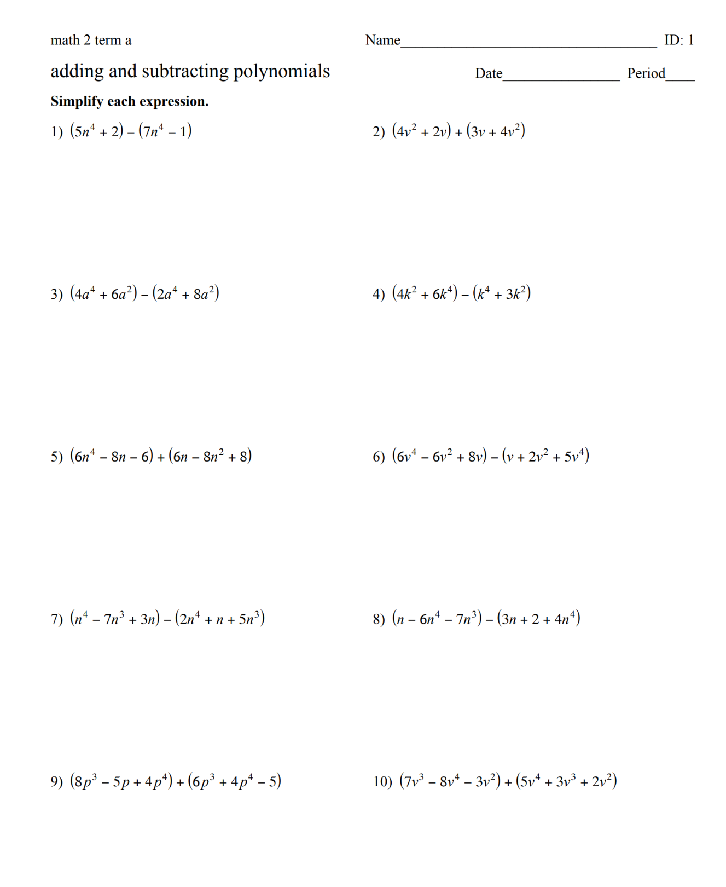
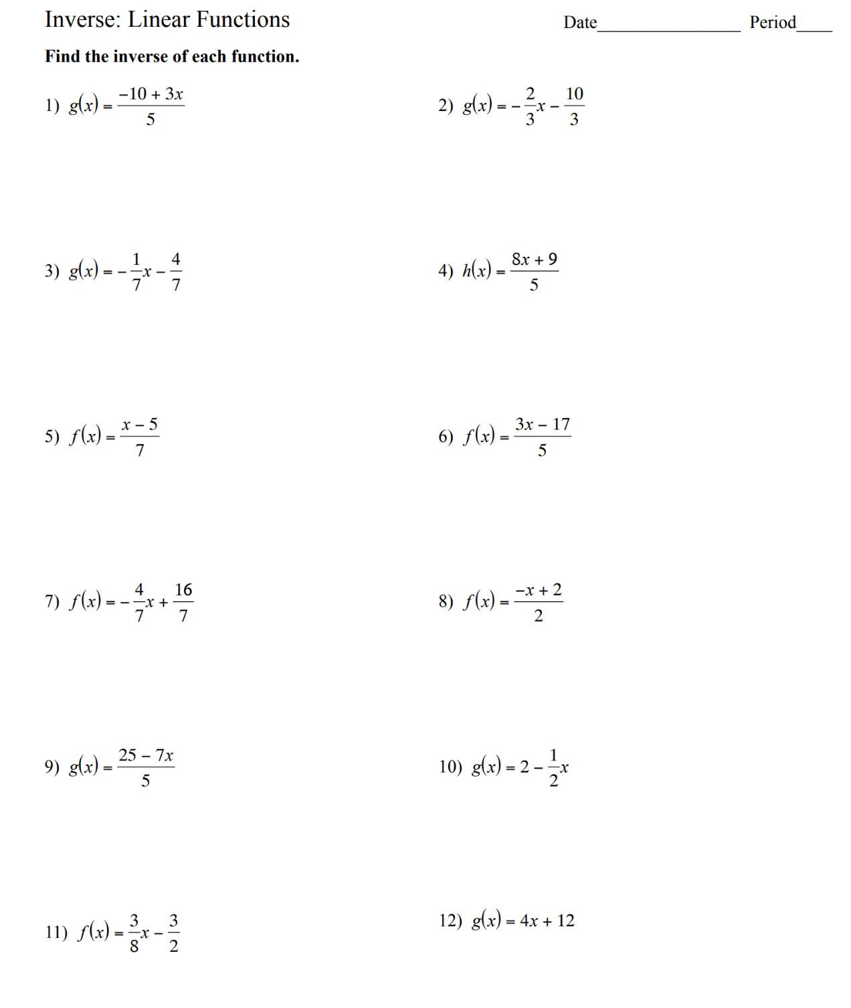
Quantitative Analysis
15 Algebra 2 assignments
Prompt :
"Complete the assignment using the
specified [ ] method"
Rubric:
1 | 2 | 3 | 4
Completes little to none of the assignment with little to no accuracy | Completes part of assignment with partial accuracy | Completes full assignment with partial accuracy | Completes full assignment with full accuracy
Notes:
ali

Slide 4
Quantitative Analysis Results
Successes | Failures
Interpreting word problems | Geometry based problems
Formula-based problems | Interpreting/creating graphs, charts, and tables
Quadratic Functions | Highly inconsistent
Notes:
ali

Slide 5
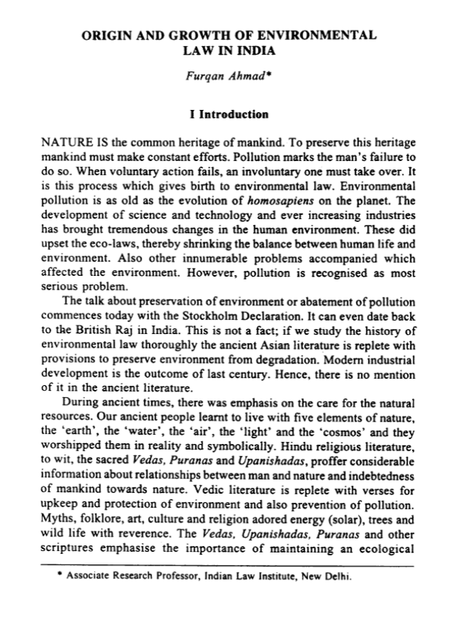
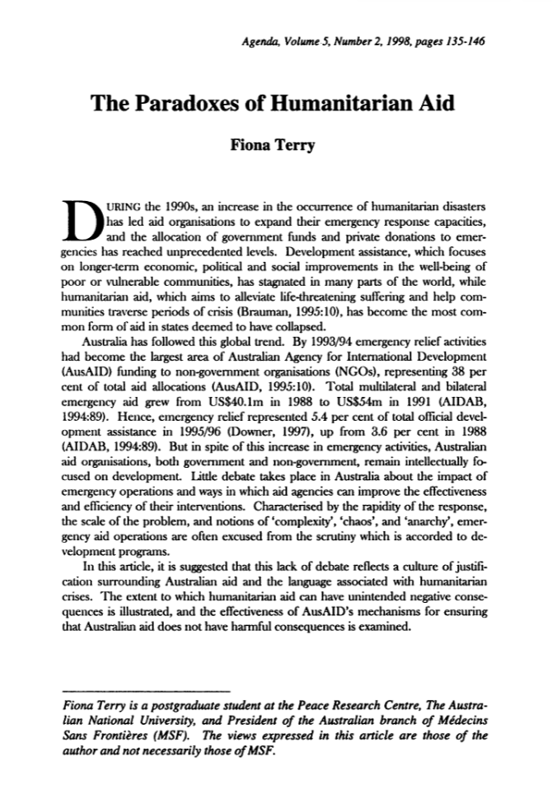
Qualitative Analysis
15 Papers varying in length (Open Source websites, Academic Journals)
Prompt:
"Help me write a 500/1000/1500 word thesis of [Article Title, Author]. Cite the author in MLA format and conclude with your opinion."
Notes:
komal

Slide 6
Qualitative Rubric
Qualitative Assignment Score: ​ | ​1 ​ | ​2 ​ | ​3 ​ | ​4 ​
Format ​ | ​Is not formatted like a paper, mainly uses bullet points ​ | ​Some cohesive paragraphs, mainly bullet points ​ | ​Mainly paragraphs, some bullet points, includes headers ​ | ​Formatted like a paper ​
​Citations ​ | ​Cannot display accurate citations ​ | ​Only provides author name, but has incorrect details ​ | ​Occasional mistakes but has accurate citations in text ​ | ​Completely accurate citations ​
​Original Comparision ​ | ​Does not compare to the original ​ | ​Has similar talking points but is too vague ​ | ​Good talking points and covers major points in the article ​ | ​Accurately encompasses the content of the article ​
​Sequencing/ ​ Comprehension ​ | Doesn’t pull content in the order of the article ​ | ​Some major points from the article are missing ​ | ​Pulls main points in the order of the article, but misses smaller details ​ | ​Pulls all the content from the article in the order of the article ​
​Opinion/Originality ​ | ​Unable to provide an original thought ​ | ​Provides some opinion ​ | Passes as an original opinion | Thought provoking opinion
Notes:
Samariddin

Slide 7
Qualitative Analysis Results
Successes | Failures
Formatting | Citations
Word Limits | Original Opinions
English Syntax | Output varied
Notes:
komal

Slide 8
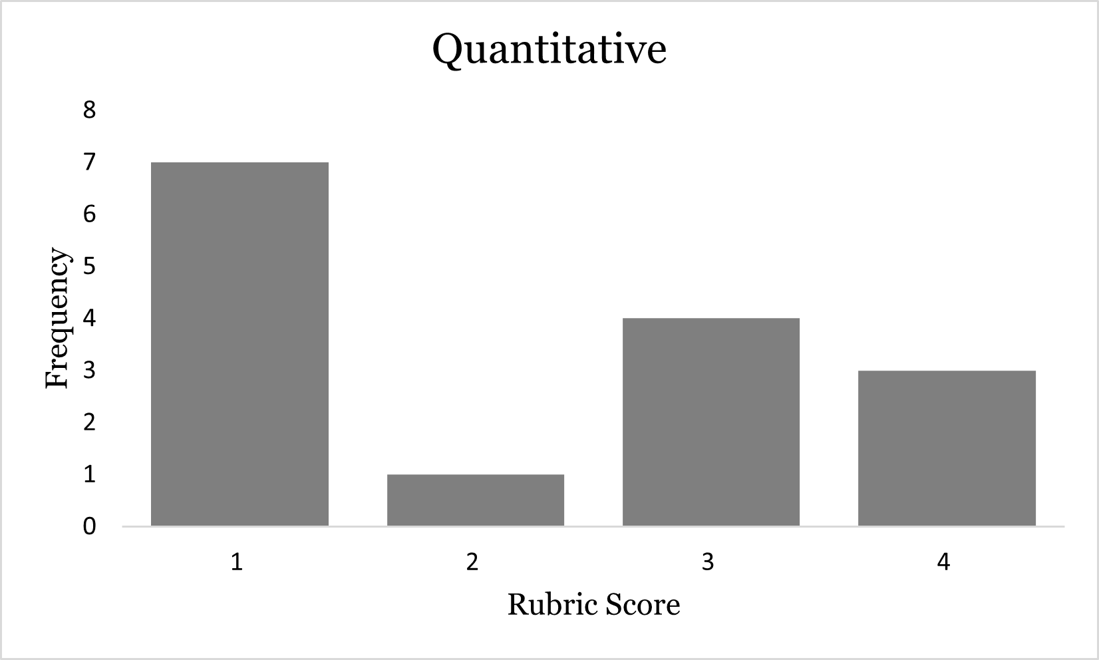
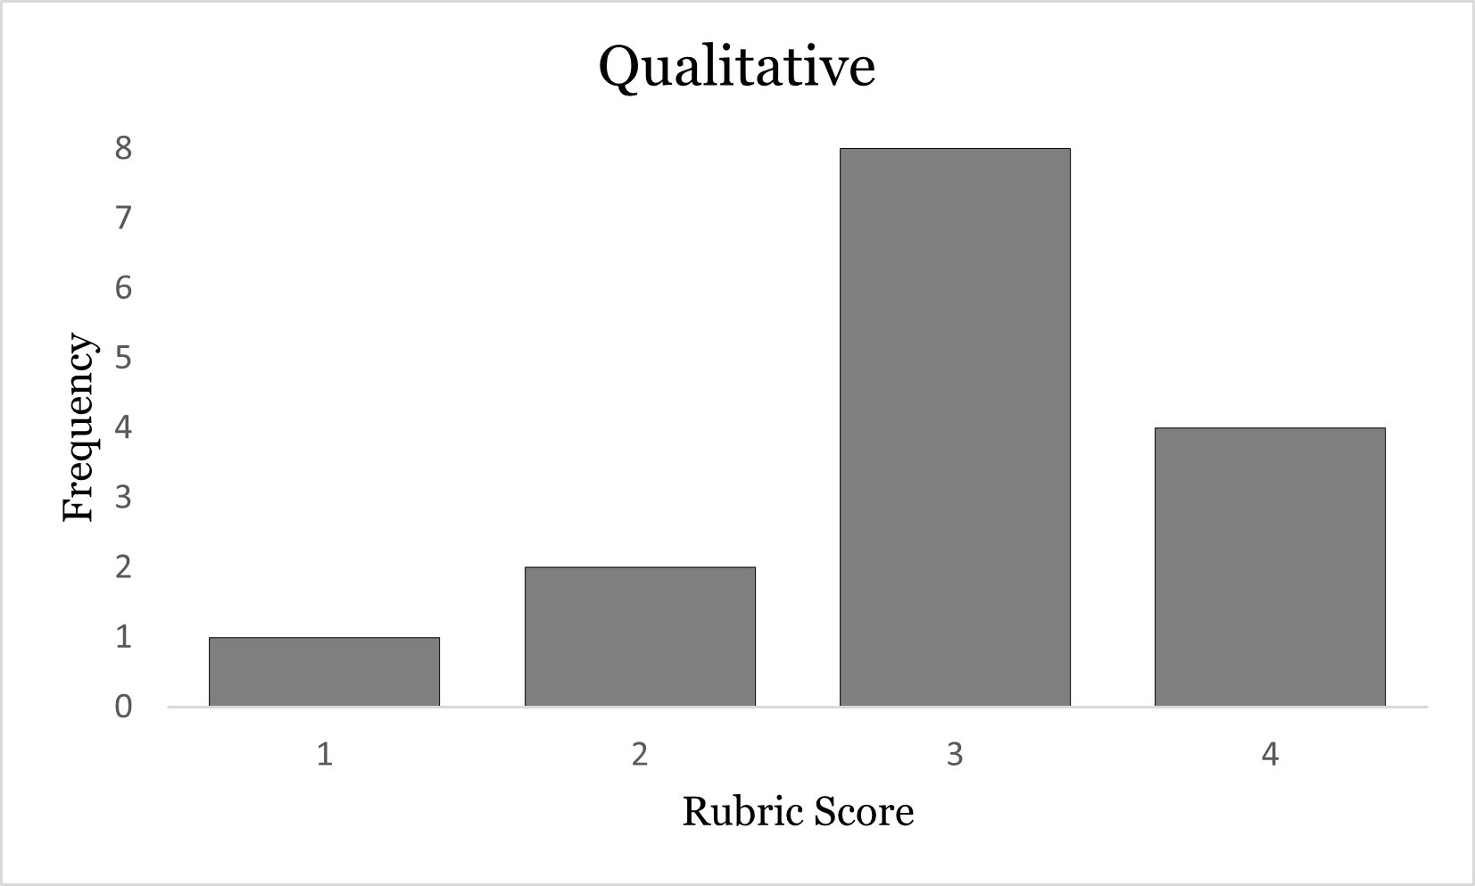
Quantitative vs. Qualitative
Notes:
ali

Slide 9
CONCLUSION
Qualitative
over
Quantitative
Lower Standard Output than Human

Slide 10
REFERENCES
Ahmad, Furqan. “ORIGIN AND GROWTH OF ENVIRONMENTAL LAW IN INDIA.” Journal of the Indian Law Institute, vol. 43, no. 3, 2001, pp. 358–87. JSTOR, http://www.jstor.org/stable/43951782. Accessed 13 Sept. 2023.
Auboin, Marc. “Improving the Availability of Trade Finance in Low-Income Countries: An Assessment of Remaining Gaps.” Oxford Review of Economic Policy, vol. 31, no. 3/4, 2015, pp. 379–95. JSTOR, http://www.jstor.org/stable/43741335. Accessed 13 Sept. 2023.
Axelson, Ulf and Makarov, Igor (2016) Informational black holes in financial markets. Financial Markets Group Discussion Papers (754). Financial Markets Group, The London School of Economics and Political Science, London, UK
Baconi, Tareq. TESTING THE WATER: HOW WATER SCARCITY COULD DESTABILISE THE MIDDLE EAST AND NORTH AFRICA. European Council on Foreign Relations, 2018. JSTOR, http://www.jstor.org/stable/resrep21615. Accessed 13 Sept. 2023.
Ehmke, Rachel. "How Using Social Media Affects Teenagers". https://childmind.org/article/how-using-social-media-affects-teenagers/. Accessed 13 Sept. 2023
Fleming, Sean. "Corruption costs developing countries $1.26 trillion every year - yet half of EMEA think it's acceptable". https://www.weforum.org/agenda/2019/12/corruption-global-problem-statistics-cost/. Accessed 13 Sept. 2023
Gale. "Global Warming". https://www.gale.com/open-access/global-warming. Accessed 13 Sept. 2023
Hiskes, Richard P. “The Right to a Green Future: Human Rights, Environmentalism, and Intergenerational Justice.” Human Rights Quarterly, vol. 27, no. 4, 2005, pp. 1346–64. JSTOR, http://www.jstor.org/stable/20069836. Accessed 13 Sept. 2023.

Slide 11
REFERENCES
Irena Gao, Marynia Kolak. "Healthy Access for Healthy Places: A Multidimensional Food Access Measure". https://arxiv.org/. Accessed 13 Sept. 2023
Lerner, Josh, and Ramana Nanda. “Venture Capital’s Role in Financing Innovation: What We Know and How Much We Still Need to Learn.” The Journal of Economic Perspectives, vol. 34, no. 3, 2020, pp. 237–61. JSTOR, https://www.jstor.org/stable/26923549. Accessed 13 Sept. 2023.
Mackenzie, Jillian. "Air Pollution: Everything You Need to Know". https://www.nrdc.org/stories/air-pollution-everything-you-need-know#whatis. Accessed 13 Sept. 2023
Pellow, David N., and Robert J. Brulle. “Poisoning the Planet: The Struggle for Environmental Justice.” Experts@Minnesota, 1 Jan. 1970, experts.umn.edu/en/publications/poisoning-the-planet-the-struggle-for-environmental-justice.
RAY, PARTHA. “Rise and Fall of Industrial Finance in India.” Economic and Political Weekly, vol. 50, no. 5, 2015, pp. 61–68. JSTOR, http://www.jstor.org/stable/24481336. Accessed 13 Sept. 2023.
Ritter, Jay R. “Forensic Finance.” The Journal of Economic Perspectives, vol. 22, no. 3, 2008, pp. 127–48. JSTOR, http://www.jstor.org/stable/27648264. Accessed 13 Sept. 2023.
Terry, Fiona. “The Paradoxes of Humanitarian Aid.” Agenda: A Journal of Policy Analysis and Reform, vol. 5, no. 2, 1998, pp. 135–46. JSTOR, http://www.jstor.org/stable/43199462. Accessed 13 Sept. 2023.

